Slide 1
PrePay Club Gifting
Be ready this holiday season with a manageable gift club option

Slide 2
What we are Covering Today!
What clubs work best for pre-pay
How to set up a pre-pay club
Adding customers to a pre-pay gift club

Slide 3
What type of club works best for a Pre-Pay Club
Be ready this holiday season with a manageable gift club option

Slide 4
What Type of Pre-Pay Club
Allocated Prepay
Is a set number of shipments
Does not require a Credit Card on file
Can be added to a giftee’s account
More predictable inventory and logistics needs
A menu of options can be provided at the time of purchase
User Choice Prepay
Is a set number of shipments
Requires a Credit Card on file for incidentals
Should be kept on the giftor’s account
Creates variable inventory and logistics needs
Admin will need to control giftee’s selections to ensure that there is no loss.

Slide 5
Setting up a Pre-Paid Gift Club
Be ready this holiday season with a manageable gift club option

Slide 6
Do I make a new club or use an existing one?
Question
I have user choice clubs
I have standard allocation clubs
I use Allocations
I have a standard allocation club, but I want a different discount rate for the Pre-Pay option
I want the benefits of the Pre-pay member to be different from any of my other clubs
Answer
Make a new club
Use your existing clubs.
Make a new club
Use your existing clubs.
Make a new club

Slide 7

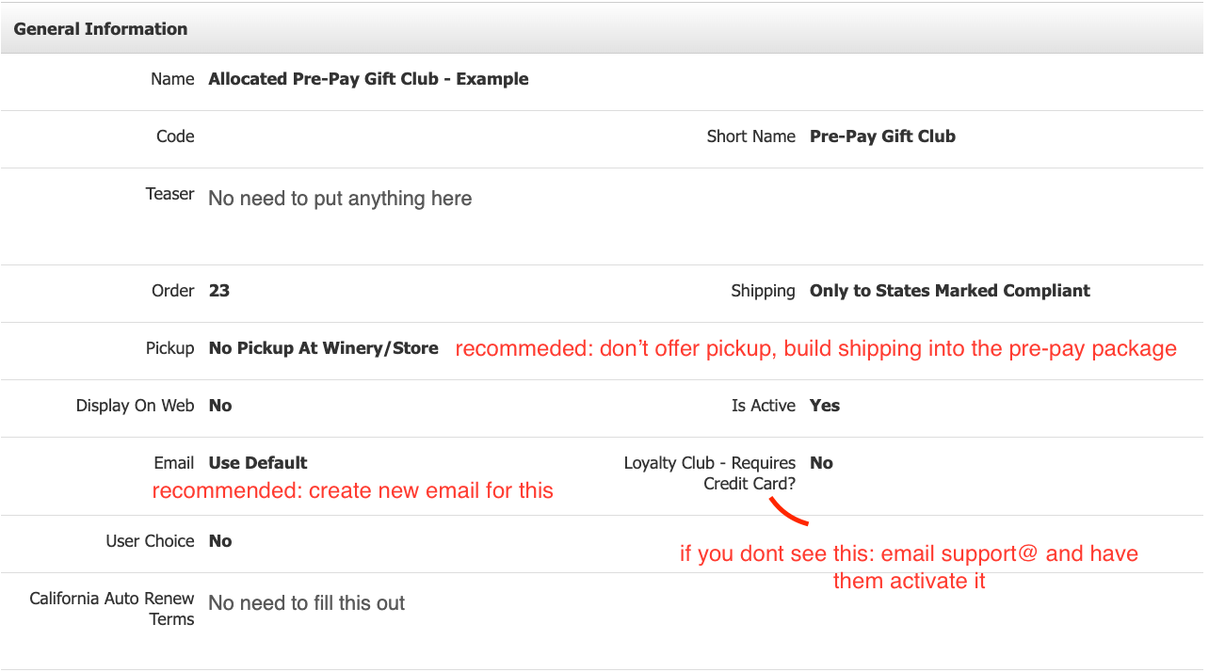
Make New:
Step 1 – Navigate to Store > Club > Add a Club
Step 2 – Fill out General information
    No need to fill out Teaser, California Auto Renew Terms, or Club Description.
    For Loyalty Club Mark as ’No’ (if you don’t see this email support@ to have it activated)
    Recommendations: Do not allow pickup for this club, Create a new email for this club.

Slide 8
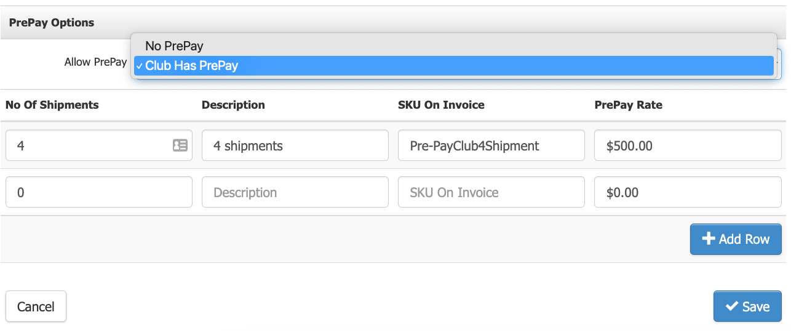
Make New or Add to Existing
Step 3 – Scroll down to PrePay Options.
Step 4 – Click Edit and Define that the Club Allows PrePay.
Step 5 – Create as many cycle options as you would like to offer and the associated price.

Slide 9
Adding PrePay Club to a User Account
BE READY THIS HOLIDAY SEASON WITH A MANAGEABLE GIFT CLUB OPTION

Slide 10
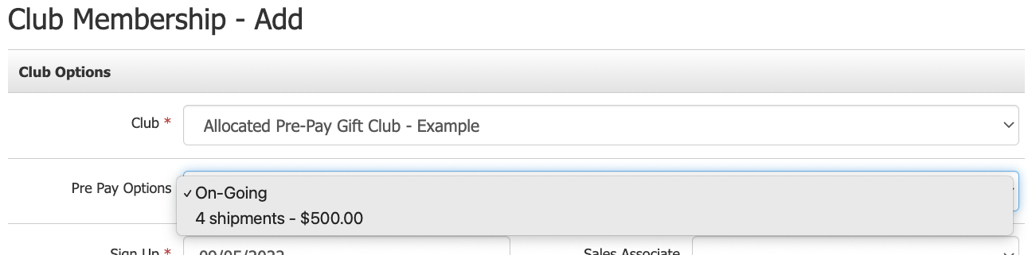
Make New PrePay Membership:
Step 1 – Make a new contact or open an existing contact
Step 2 – Fill out general information
Step 3 – Add club membership and select the appropriate PrePay Option:
Step 4 – In Payment Options select add new credit card and add the Giftor’s Credit card information. Then click Save.
Step 5 – After Saving open Payment options again and change Payment options to ‘Loyalty Club – Requires Credit Card?’ and Save again

Slide 11
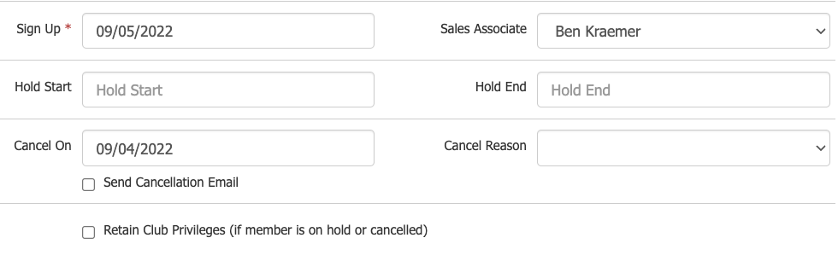
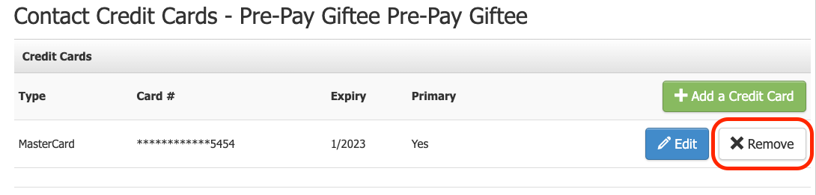
Remove Giftor’s Credit Card from Account:
Step 1 – Cancel the PrePay Club the day before sign up date. Save.
Step 2 – Open Manage Credit Cards and Remove Giftor’s Credit Card
Step 3 – Open PrePay Club and remove Cancellation Date.

Slide 12
Bonus Material
BE READY THIS HOLIDAY SEASON WITH A MANAGEABLE GIFT CLUB OPTION

Slide 13
Formula to calculate Allocated Pre-Pay Club
Example:
 | Number of shipments | 4 |  | Bottle Requirement | 12 |  | Shipmnet 1 | $101.60
 | Bottles Per shipment | 3 |  | Discount offered | 20% |  | Shipmnet 2 | $79.20
 |  |  |  |  |  |  | Shipmnet 3 | $84.00
 | Product List: |  |  |  |  |  | Shipmnet 4 | $107.20
 | Shipment 1: |  | Quantity | Retail | Discount
 |  | 2019 Cab Sauv. | 1 | $55.00 | $44.00 |  | Shipments Total | $372.00
 |  | 2020 Reserve Chard. | 1 | $30.00 | $24.00
 |  | 2019 Merlot. | 1 | $42.00 | $33.60 |  | Average Per Shipment | $93.00
 |  |  |  |  | $0.00
 |  |  |  |  | $0.00 |  | Shipping Flat Rate | $15.00
 |  |  |  |  | $0.00 |  | Shipping Total | $60.00
 | Shipment 2:
 |  | 2019 Reserve Pinot | 1 | $46.00 | $36.80 |  | Total Pre-Pay Cost | $432.00
 |  | 2021 Sauv Blac. | 1 | $28.00 | $22.40
 |  | 2021 Rose | 1 | $25.00 | $20.00 |  | Retail Value | $500.00
 |  |  |  |  | $0.00
 |  |  |  |  | $0.00 |  | Handling | $68.00
 |  |  |  |  | $0.00
 | Shipment 3:
 |  | 2019 Merlot. | 1 | $42.00 | $33.60
 |  | 2020 Reserve Chard. | 1 | $30.00 | $24.00
 |  | 2020 Sparkling | 1 | $33.00 | $26.40
 |  |  |  |  | $0.00

Slide 14
Thank You!
Please let us know how we are doing, and feel free to reach out to us for 1:1 training
training@winedirect.com

